Slide 1
CHOOSING A NEIGHBOURHOOD WITH THE IDEAL CONDITIONS TO OPEN A MEXICAN RESTAURANT

Slide 2
Introduction
According to the Center for Latin American, Caribbean and Latino Studies:
Mexicans were the third largest Latino national subgroup in the City and increased from 58,000 and 3% of all Latinos in 1990 to 377,000 and 15% of the New York’s Hispanic population in 2015. Between 1990 and 2010 Mexicans had been the fastest growing Latino nationality but growth, and probably migration to the City, slowed considerably after 2010.
Mexicans were concentrated in Queens where 31% lived, Brooklyn 30%, and Manhattan 22%.
Latinos were the youngest of all race/ethnic groups in the City with a median age of 33 in 2015. Mexicans were the youngest of the Latino nationalities with a median age of 26 followed by Dominicans at 32, Ecuadorians at 33, Puerto Ricans, 37, and Colombians at 41.

Slide 3
Problem
Data that might contribute to determining the ideal location for a Mexican restaurant, for example areas where people from Mexican descent are living or where people tend to look for Mexican food. This project aims to identify an area of the city where an Authentic Mexican Restaurant that aims to become one of the best of the city could be placed.

Slide 4
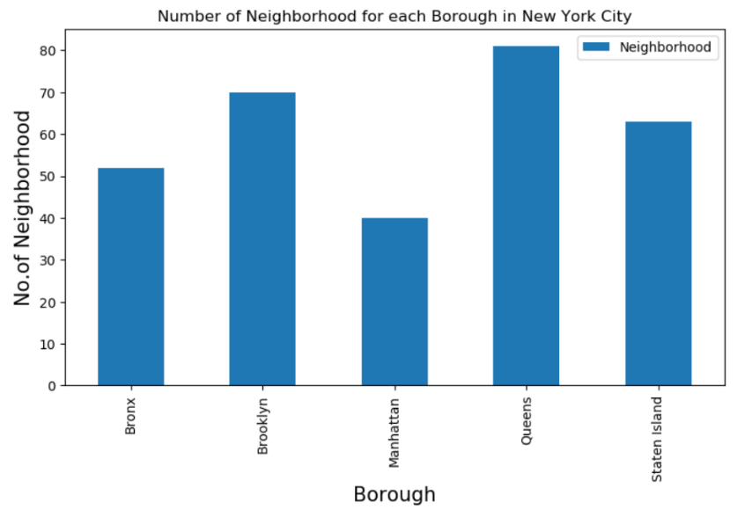
Data
I obtained the geographical information of the New York City Neighbourhoods

Slide 5
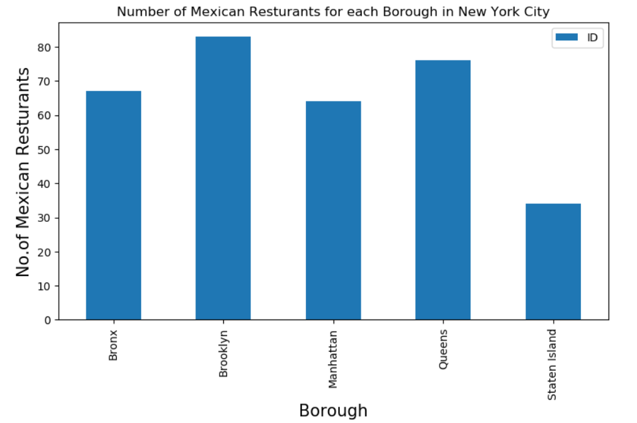
Data
Considering this information I decided to find our where the largest concentration of Mexican Restaurants are

Slide 6
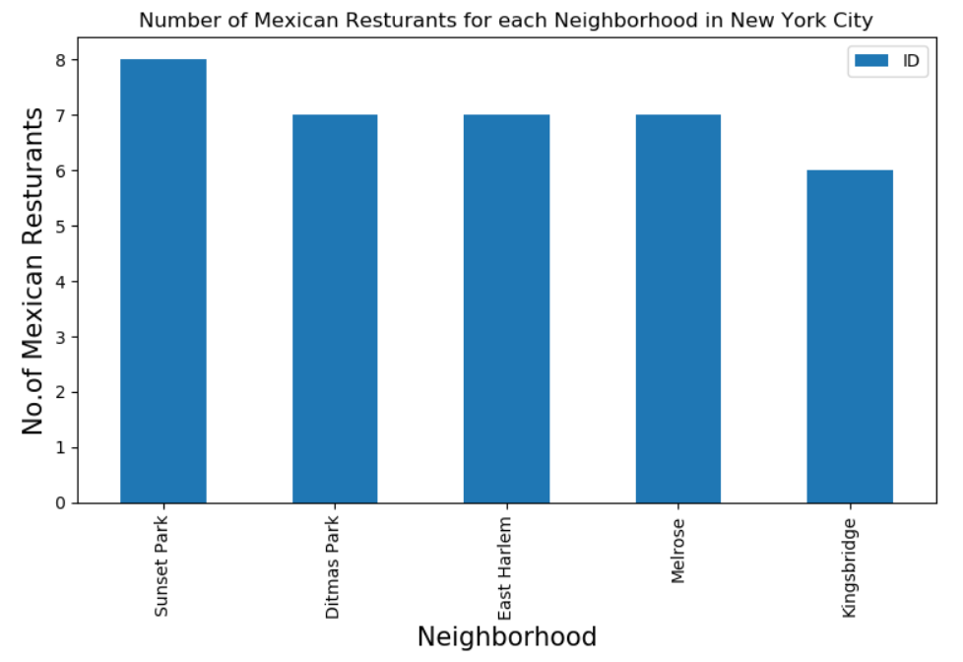
Data
Considering this information I decided to find our where the largest concentration of Mexican Restaurants are

Slide 7
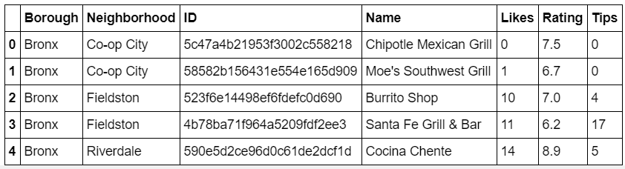
Data
I decided to obtain the ratings for the Restaurants that are established there obtaining the following:

Slide 8
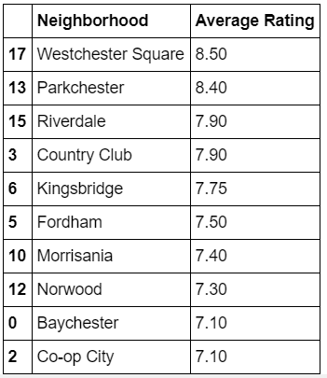
Data
The best rating obtained is of 8.9 according to Foursquare information, in order to see how well rated it is from all the restaurants in the city we need to get the top-rated restaurant to compare it with. In this case it is the Taquería Tlaxcali that is in the Bronx at Parkchester with a rating of 9.1.

Slide 9
Conclusion
Given that the top average ratings are in Neighborhoods other than Sunset Park, this makes Sunset Park an area with a high possibility of success if the restaurant established is ranked above a 7.26 rating which is the average rating in Sunset Park. Also it is important to consider that 4 of the 5 top ranking restaurants in the neighborhood are chain restaurants, it would give a family owned restaurant advantage given that it could be considered an authentic cuisine.

